Slide 1
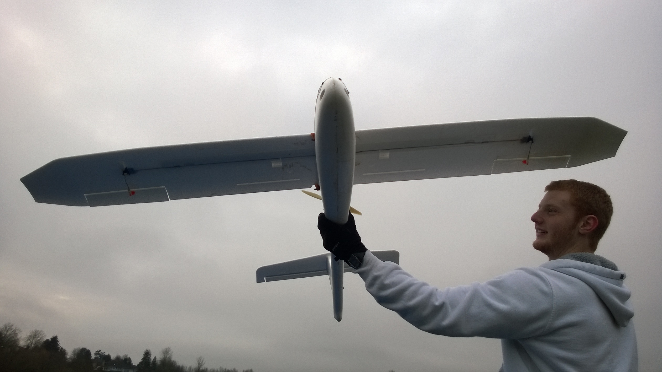
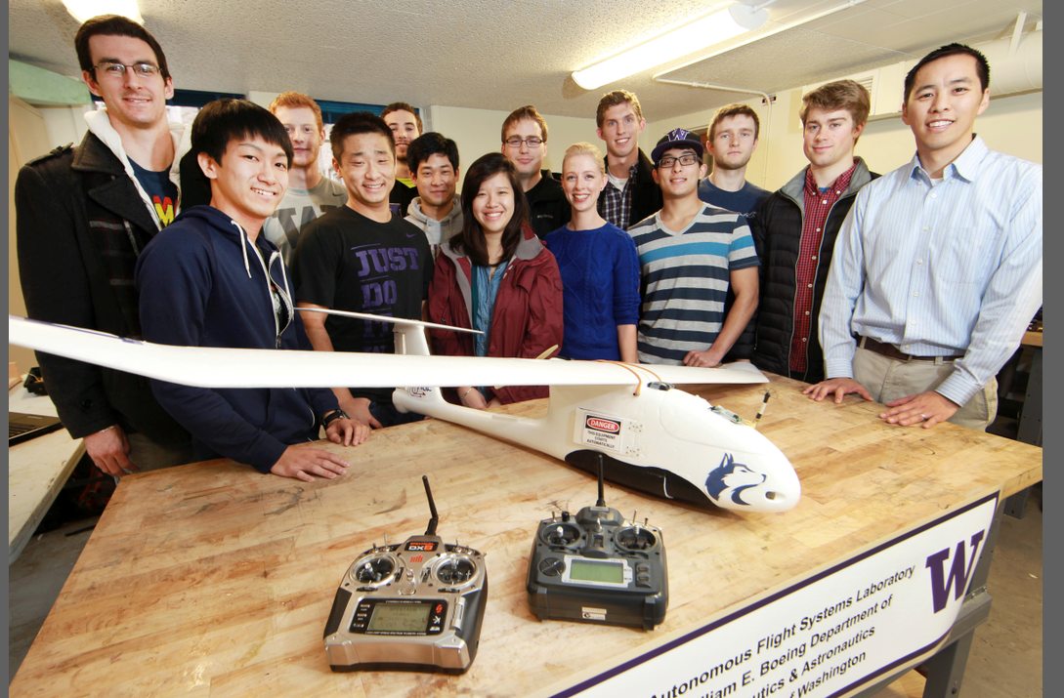
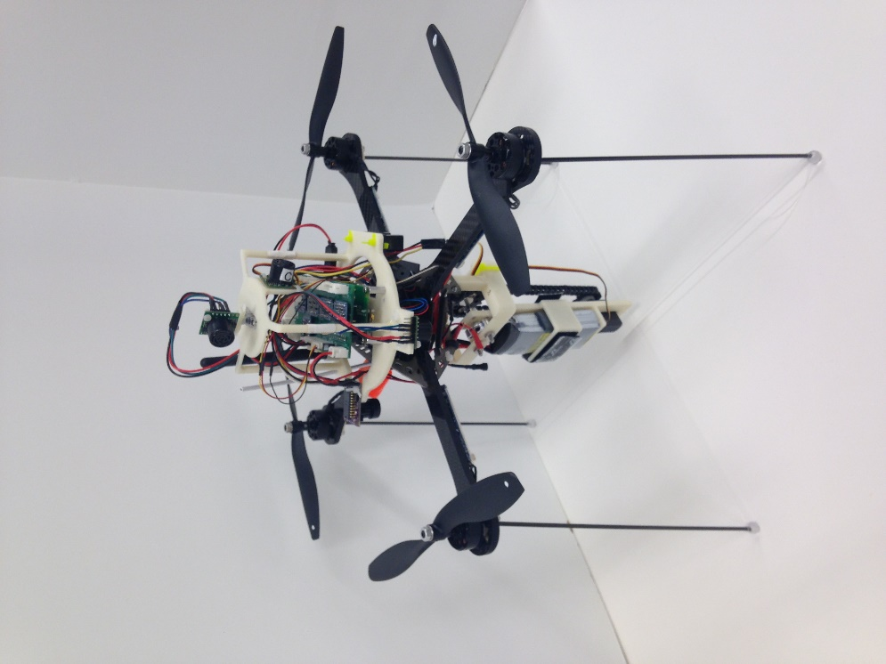
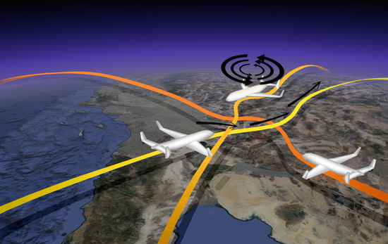
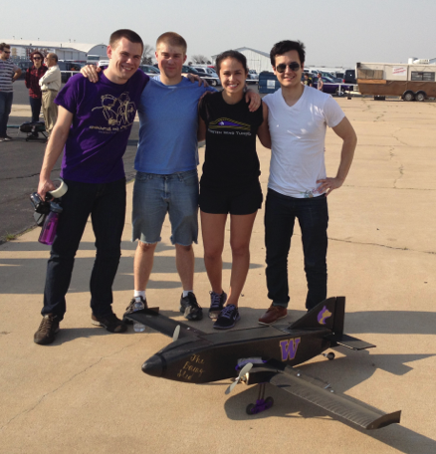
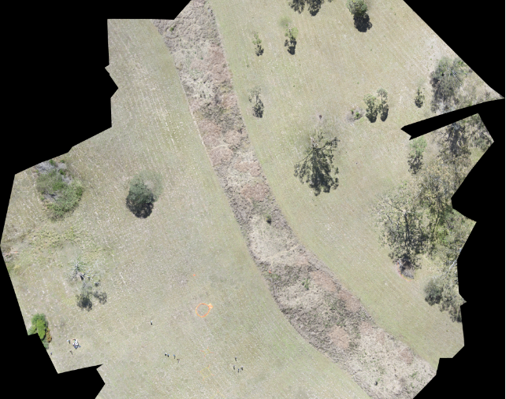
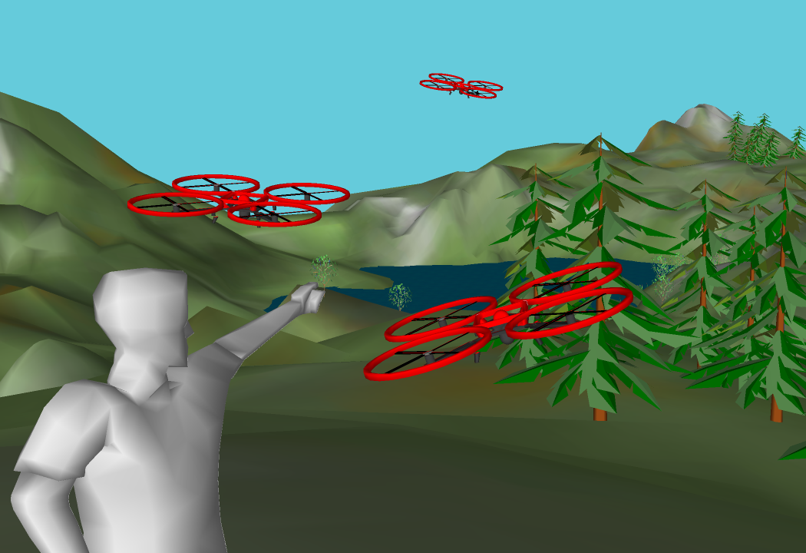

William E. Boeing Department of Aeronautics & Astronautics
Unmanned Aerial Systems
The next aerospace revolution
HEADLINE
The Unmanned Aerial Systems (UAS) industry is one of the fastest-growing industries in the United States. Traditionally, UAS have been a military tool used primarily for performing intelligence, surveillance, and reconnaissance missions. However, with the Federal Aviation Administration (FAA) actively integrating these systems into the National Airspace System (NAS), civilian and commercial usage of UAS is expected to increase dramatically in the next several years.
Small and medium sized UAS will likely experience the greatest near-term growth in civil and commercial operations.
Washington State stands to gain nearly 10,000 jobs and $7.8 billion as this market expands over the next decade.
Now is the time to become involved as commercial usage of UAS have only recently become authorized by the FAA.
research at the university of Washington
The University of Washington (UW) is the premiere research institution in the Pacific Northwest with active research programs and expertise in UAS. The UW William E. Boeing Department of Aeronautics & Astronautics conducts UAS related research in areas such as:
UAS for precision agriculture and farming.
Topographical, ecological, & biological monitoring w/ UAS.
Disaster response and search and rescue using UAS.
UAS operator/pilot training and interface design.
UAS flight control and avionics verification and validation.
Collaboration and control of swarms of UAS.
Operation of UAS in GPS-denied environments.
Wildfire monitoring and detection using UAS.
Biologically inspired engineered UAS systems.
Control of networked UAS systems.
Collision awareness, avoidance, and airspace management.

Slide 2
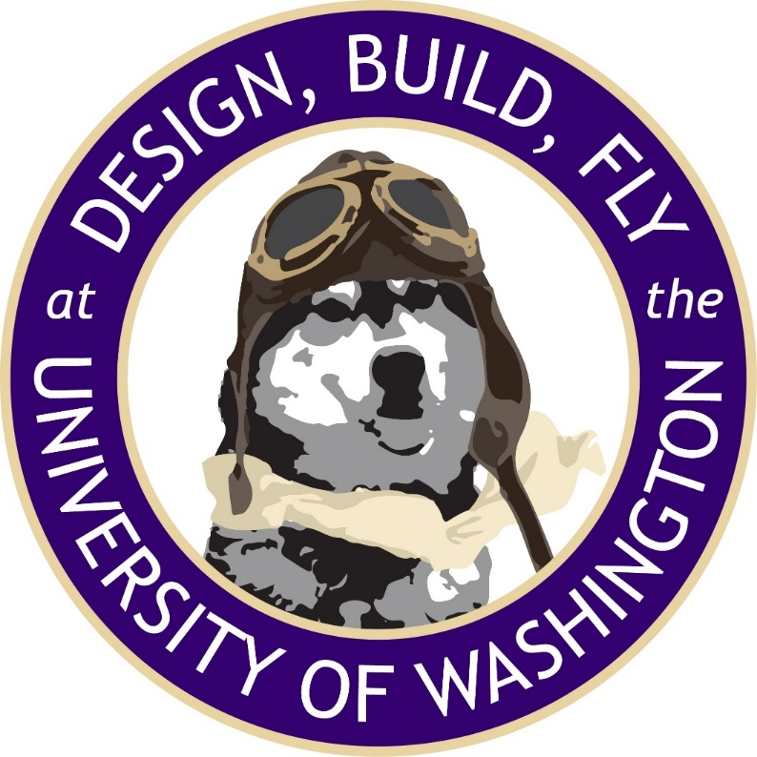
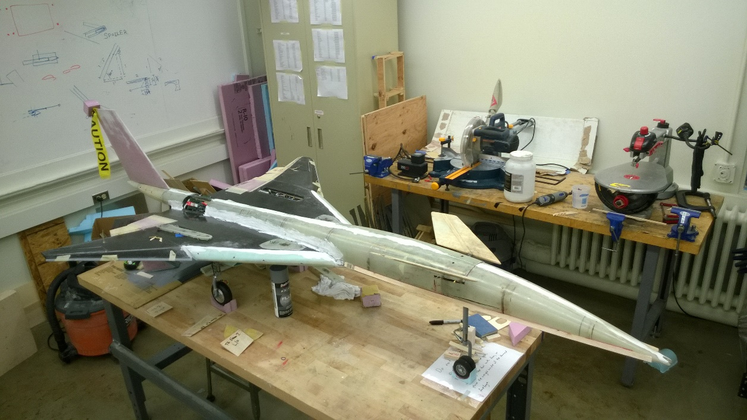
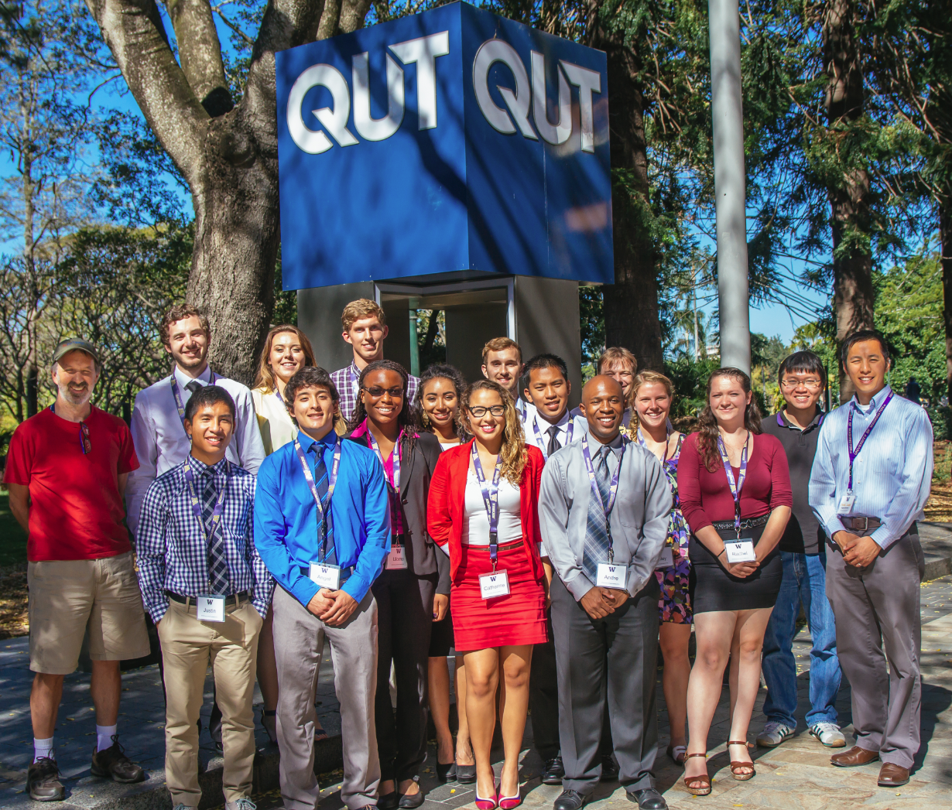
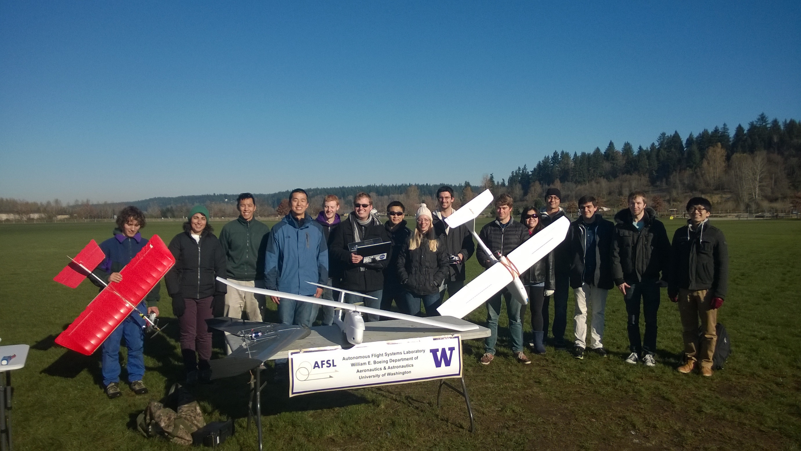


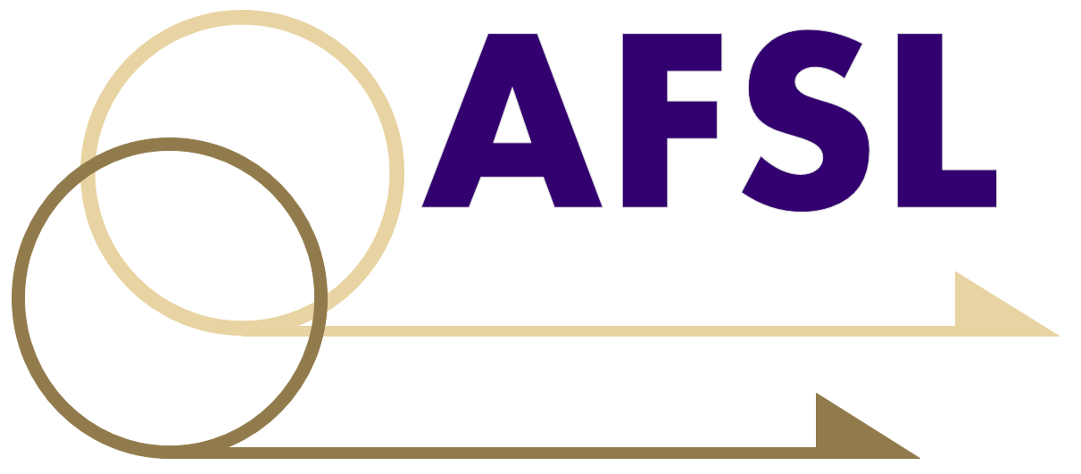
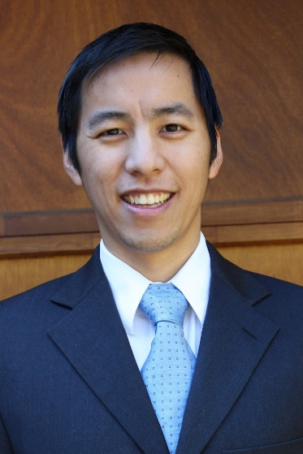


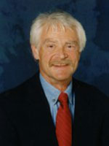
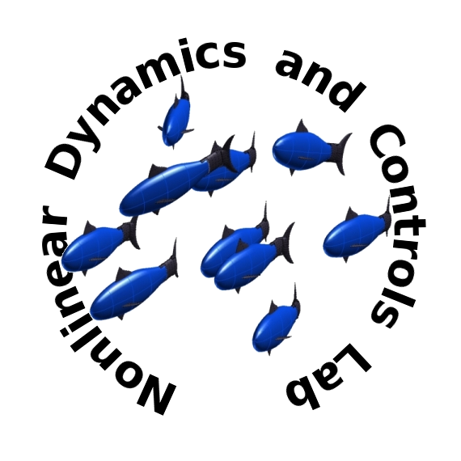
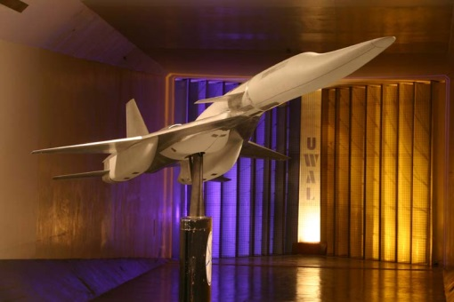

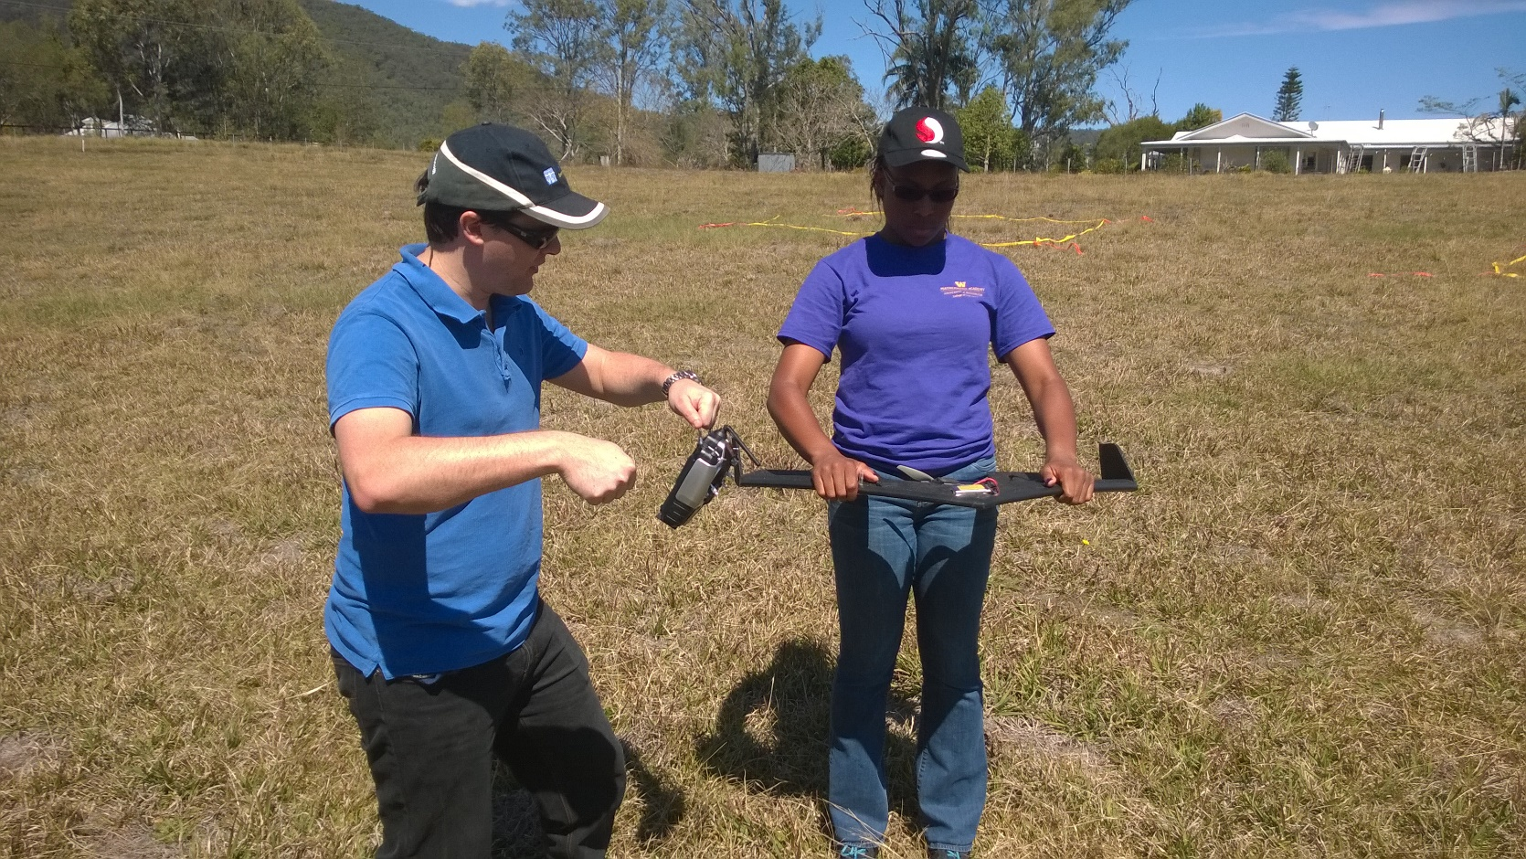
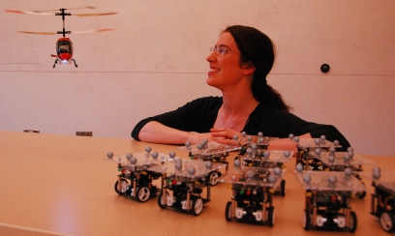
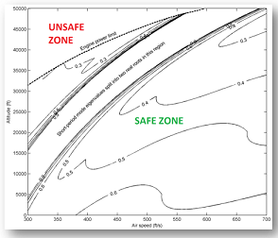
William E. Boeing Department of Aeronautics & Astronautics
Vast educational potential
Design, Build, Fly
Each year UW students participate in the AIAA Design/Build/Fly competition. Student teams design, fabricate, and demonstrate the flight capabilities of an unmanned, electric powered, radio controlled UAS that can best meet the specified mission profile.
UAS provide an excellent platform for student education within Washington State. The UW has several educational programs, courses, and activities that involve UAS related technologies.
Senior Aircraft Design
Senior undergraduate students with an interest in aeronautical engineering can participate in a rigorous, 6 month course focusing on design, analysis, manufacture, and flight testing of a custom aircraft.
Dawgs Fly
Dawgs Fly is a registered student organizations at the UW that focuses on radio controlled (RC) flight. It attracts aviation enthusiasts and hobbyists from many departments on campus. Students are exposed to the world RC aircraft with a focus on UAS systems and technologies.
UAS Study Abroad Australia
Each summer, the UW conducts a study abroad class in Brisbane, Australia at the Queensland University of Technology (QUT). This class focuses on UAS and collaboration with other robotic systems. Students learn about UAS and their impact on the global economy and society.
Dr. Eli Livne teaches aircraft design and specializes in multi-disciplinary optimization.
Dr. Kristi Morgansen investigates bio-inspired engineering applications and systems related to UAS.
People and laboratories
The UW has a diverse group of researchers and laboratories dedicated to UAS research.
Autonomous Flight Systems Laboratory
The mission of the AFSL is to support advances in guidance, navigation, & control technology relevant to autonomous vehicles and their payloads. A parallel objective is to integrate this technology into deployed systems by partnering with industry partners.
Dr. Christopher Lum is focused on UAS algorithm design and flight operations at UW.
Dr. Anshu Narang-Siddarth is an expert in flight control law verification and certification.
Dr. Mehran Mesbahi researches networked systems and optimization algorithms.
Dr. Juris Vagners is focused on UAS systems development and transitioning academic ideas onto industry platforms and products.
Nonlinear Dynamics & Control Laboratory
This laboratory is focused on control and sensing methods for nonlinear and coordinated control systems. Current research topics include the integrated sensing and actuation for bio-inspired agile flight and cognition in multi-agent systems.
Robotics, Aerospace & Information Networks
This group investigates theory, computation, and experimentation of UAS technologies with specialization in networked systems. This lab also investigates optimization and algorithms for single and multiple vehicles.
Advanced Dynamics, Validation & Control Research Laboratory
The overall research objective is to address the problem of analysis and control for today's intrinsically nonlinear, unstable, high-dimensional multi-scale nature of autonomous operations.
Are you interested in UAS at UW? Please contact:
Gaia Brown, gaiab@aa.washington.edu, (206) 543-8864
http://www.aa.washington.edu

